Slide 1

CLASS VISION
Interim Review
Guided by,
Mr.Thomas George
Assistant Professor
Dept.CSE
JECC
Presented by,
JEC21CS010 | Aditya Manoj A
JEC21CS018 | Alicia Denny
JEC21CS027 | Andrea James
JEC21CS056 | Godfrey George Geejo

Slide 2
CONTENTS
Introduction
Objectives
Literature review
Methodology
Work done during review period
Challenges
Work schedule
Expected Outcome
References

Slide 3
INTRODUCTION
Enhances accuracy and security by eliminating manual attendance errors.
Utilizes real-time data analytics for actionable insights on attendance trends.
Designed for ease of use, minimizing manual intervention.
Built for reliability and adaptability, ensuring future expansion and evolving institutional needs.
Provides educational institutions with a secure, efficient, and future-proof classroom management solution.

Slide 4
OBJECTIVES
Automate Classroom Management
Enhance Accuracy and Security
Provide Real-Time Data Analytics
Improve User Experience
Ensure Scalability and Reliability

Slide 5
LITERATURE REVIEW
Author, year | Title/Journal | Findings | Inference/Contribution to the present study
Chirag Dalvi, Manish Rathod, Shruti Patil, 2021 | AI-Based Facial Emotion Recognition: Features, ML & DL Techniques, Age-Wise Datasets and Future Directions | Demonstrates how facial expressions can significantly impact the accuracy and responsiveness of AI-based recognition systems. | Highlights the importance of considering facial variations for more precise recognition in classroom environments, improving overall system accuracy.
Fadi Boutros, Naser Damer, Kiran Raja, 2021 | Masked Face Recognition Competition | The competition results revealed that 10 out of 18 submitted solutions outperformed one of the top academic face recognition solutions in terms of masked face verification accuracy. | The study contributes by motivating the development of more accurate and compact face recognition models for masked faces.

Slide 6
LITERATURE REVIEW
Author, year | Title/Journal | Findings | Inference/Contribution to the present study
An Ping Song, Qian Hu, 2020 | Similar Face Recognition Using the IE-CNN Model | The study demonstrates that using a combination of large-scale similar face datasets and a fine-grained feature extraction method improves recognition accuracy significantly. | This research contributes by introducing a new fine-grained feature extraction method using the attention mechanism, which improves recognition accuracy for highly similar faces.
Chakradhar Pabba, Praveen Kumar, 2022 | An intelligent system for monitoring students' engagement in large classroom teaching through facial expression recognition | The study presents a real-time system for monitoring student engagement in large classrooms by analyzing facial expressions. | The research contributes by creating a dataset of facial expressions specific to classroom environments and integrating data from public datasets to improve model generalization.

Slide 7
LITERATURE REVIEW
Author, year | Title/Journal | Findings | Inference/Contribution to the present study
Shubhobrata Bhattacharya ,Anirban Dasgupta, Anwesha Sengupta, 2019 | Interest Indices for Human Computer Interaction Applications based on Facial Image Sequences | Proposes innovative metrics to measure user engagement and interest in human-computer interaction (HCI) applications. | Provides a framework for evaluating user experience, allowing the system to assess ease of use and adjust for a smoother interface.
Anushka Mohanty, Aditya Jain, Akshat Jain, 2021 | Classroom Management System using Facial Recognition and Speaker Diarization | The paper proposes a classroom management system that utilizes face recognition to automatically record student attendance. | This system contributes by saving teachers' time in recording attendance and identifying disruptive students without manual intervention.

Slide 8
LITERATURE REVIEW
Author, year | Title/Journal | Findings | Inference/Contribution to the present study
Ravi Kishore KodaliRaghu Vamshi Hemadri, 2021 | Attendance Management System | Identifies limitations in traditional facial recognition systems for attendance, such as poor lighting or diverse facial angles, and suggests solutions. | Offers insights into overcoming common technical challenges, ensuring the system remains reliable under various conditions.
Shahzaib Shoukat Hussain, Kashifa Qayyum, Mudassir Khalil, Omer Aziz, 2022 | Comparative Analysis of Facial Recognition Models to Record Classroom attendance with one click | The paper compares the performance of two popular face recognition algorithms, HOG (Histogram Oriented Gradient) and VGG (Visual Geometry Group), focusing on their accuracy and time efficiency. | This research contributes by providing a comparative analysis of HOG and VGG algorithms, showing their efficiency for face recognition without requiring specialized hardware.

Slide 9
LITERATURE REVIEW
Author, year | Title/Journal | Findings | Inference/Contribution to the present study
Nor Azman Ismail, Cheah Wen Chai, Hussein Samma, Md Sah Salam, 2022 | Web-based university classroom attendance system based on deep learning face recognition | The paper proposes a web-based attendance system utilizing facial recognition through open-source deep learning models. | This research contributes by detailing a method for creating dynamic face recognition systems using pre-trained models and storing feature vectors in an online database.
Iris Dominguez-Catena, Daniel Paternain, 2024 | Metrics for Dataset Demographic Bias: A Case Study on Facial Expression Recognition | The study reveals that many existing metrics for measuring demographic bias in datasets, particularly in Facial Emotion Recognition, are redundant. | This paper develops a comprehensive taxonomy for classifying bias measurement metrics, offering a practical guide for selecting appropriate tools in research.

Slide 10
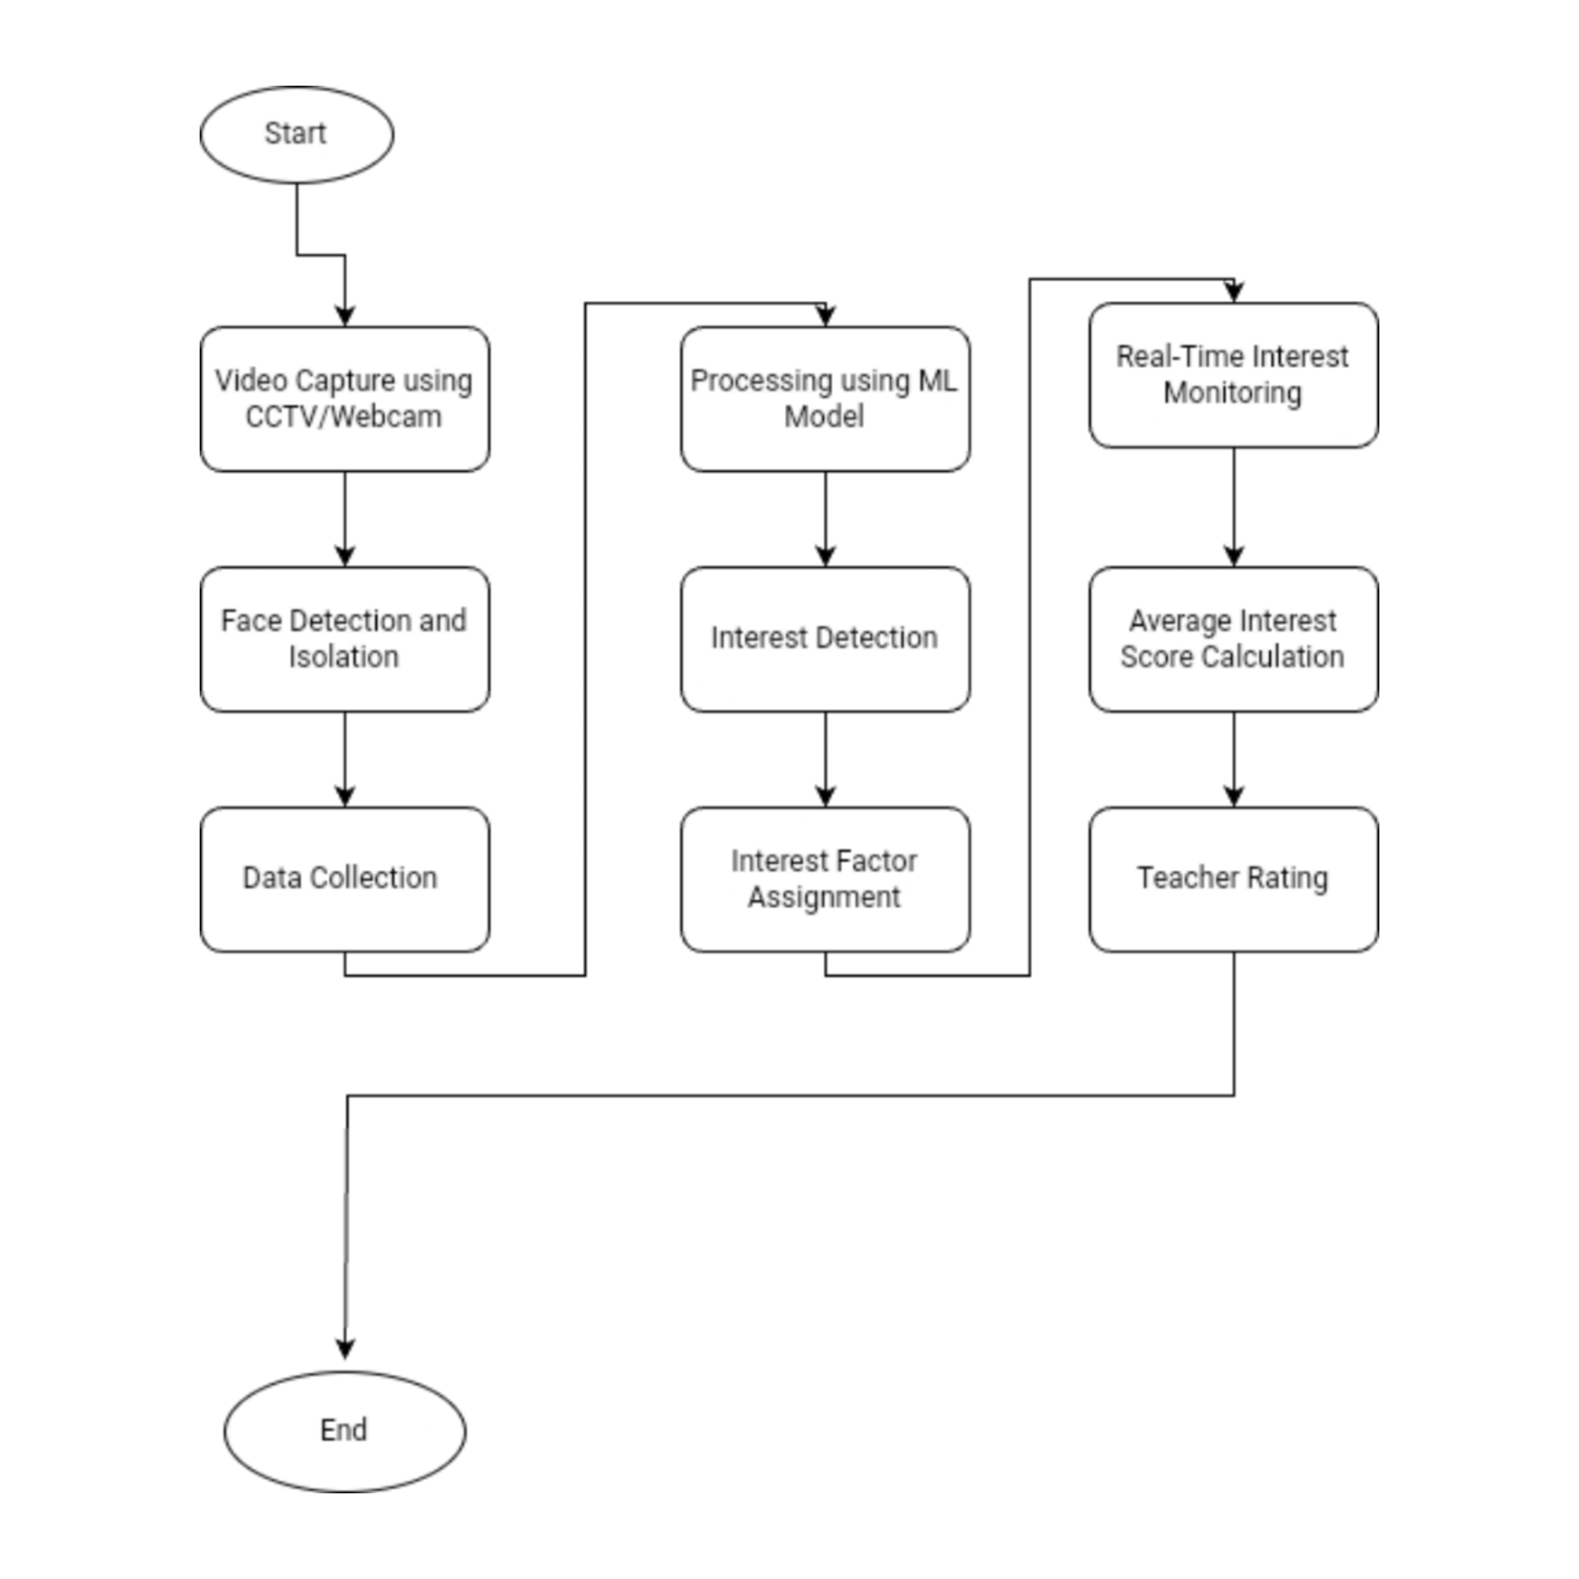
METHODOLOGY

Slide 11
WORK DONE DURING REVIEW PERIOD
1. Data Collection & Preparation:
- Gathered and prepared an initial dataset of facial expressions from online sources, focusing on emotions relevant to classroom engagement (e.g., interest, boredom, confusion).
- Preprocessed the data by resizing images, normalizing pixel values, and augmenting the dataset for variability.
2. Model Selection & Training:
Selected multiple models for training, including:
VGG16
ResNet50
InceptionV3
Implemented facial recognition and emotion detection using these models to classify student interest levels.

Slide 12
WORK DONE DURING REVIEW PERIOD
3. Training Process:
Split the dataset into training (80%) and validation (20%) sets.
- Fine-tuned pre-trained models using the dataset to optimize them for detecting student engagement.
4. Initial Results (Accuracy and Precision Rates):
VGG16:
Accuracy: 78%
Precision: 0.80
ResNet50:
Accuracy: 82%
Precision: 0.84
InceptionV3:
Accuracy: 80%
Precision: 0.82

Slide 13
WORK DONE DURING REVIEW PERIOD
5. Initial Findings:
- ResNet50 showed the highest accuracy and precision in detecting student interest during the initial training phase.
- The models are being refined with additional data and hyperparameter tuning for better performance.

Slide 14
CHALLENGES
1. Model Selection:
- Issue: Difficulty in selecting the most appropriate facial recognition model from several candidates.
- Solution: Conducted comparative analysis of models like CNN, ResNet, and VGG to evaluate their performance.
2. Data Preprocessing:
- Issue: Initial challenges with preprocessing large datasets, including image resizing, normalization, and augmentation.
- Solution: Developed and tested preprocessing scripts to standardize data and enhance model training efficiency.
3. Performance Variability:
- Issue: Variability in model performance based on different datasets and initial configurations.
- Solution: Implemented rigorous testing and evaluation procedures to identify and address performance bottlenecks.
4. Integration Complexity:
- Issue: Complexity in integrating the facial recognition model with the classroom management system.
- Solution: Began modular integration with incremental testing to ensure seamless functionality.

Slide 15
CONCLUSION (EXPECTED OUTCOME)
Expected Technical Outcomes:
Automated Attendance Management
Elimination of manual errors and attendance fraud.
Real-time tracking and automatic attendance updates.
Enhanced Security and Accuracy
Reliable facial recognition algorithms ensure accurate identification.
Increased security by restricting unauthorized access.
Real-Time Data Analytics
Provides actionable insights on student attendance patterns.
Supports better decision-making for educational institutions.

Slide 16
CONCLUSION (EXPECTED OUTCOME)
Expected Institutional Outcomes:
Improved Operational Efficiency
Reduced time spent on attendance, allowing educators to focus on teaching.
Scalability and Flexibility
The system is adaptable to expanding classroom environments and larger institutions.
Enhanced User Experience
Streamlined interface ensures ease of use for both students and teachers.
Future-Proof Solution
Designed to support future advancements in facial recognition and educational technology.

Slide 17
WORK SCHEDULE/TIMELINE
TASK | START DATE | DURATION
Planning | 10-Aug | 5
Data Collection | 15-Aug | 9
Project Prototype | 20-Aug | 14

Slide 18
REFERENCES
IEEE Papers:
"Deep Learning for Facial Expression Recognition: A Review" IEEE Transactions on Affective Computing, 2020 DOI: 10.1109/TAFFC.2020.3032226
Discusses advancements in facial expression recognition using deep learning techniques.
"Facial Recognition Technology: A Survey" IEEE Access, 2019 DOI: 10.1109/ACCESS.2019.2914540
Provides a comprehensive review of facial recognition technologies and their applications.
"Real-Time Facial Expression Recognition with Deep Learning" IEEE Transactions on Image Processing, 2021 DOI: 10.1109/TIP.2021.3051835
Examines methods for real-time facial expression recognition using deep learning.
.

Slide 19
REFERENCES
Google Scholar:
"Facial Expression Recognition using Deep Learning: A Review" Google Scholar Link
A review article summarizing deep learning approaches in facial expression recognition.
"A Survey on Facial Recognition Technologies and Their Applications" Google Scholar Link
Overview of facial recognition technologies and their diverse applications.
"Challenges in Facial Recognition Systems: A Comprehensive Review" Google Scholar Link
Identifies and discusses the challenges faced by current facial recognition systems.

Slide 20
REFERENCES
ML Labs:
"Face Recognition with Deep Learning: A Survey" ML Labs Link
Comprehensive survey on deep learning techniques for facial recognition.
"Advancements in Facial Recognition Technologies" ML Labs Link
Discusses recent advancements and trends in facial recognition technologies.
"Real-Time Facial Recognition Systems: Techniques and Applications" ML Labs Link
Reviews techniques and applications of real-time facial recognition systems

